Slide 1
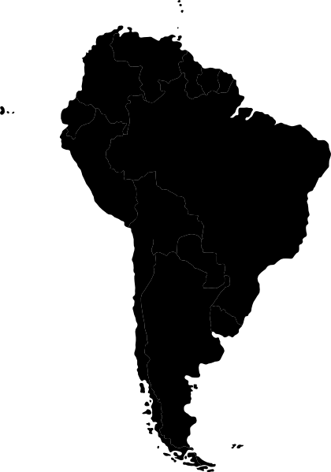



ommodities in
outh America
By: Claudia, Casey, Michael, and Yujie
March 18, 2015

Slide 2


INITIAL SETUP
DEPENDENCIES
ACCESSING QUANDL DATA
State at top of markdown so you know which tools you have running.
ie:
```{r, warning=FALSE, results='hide'}
(library(knitr))
```
Set up an free account at Quandl!
Install Quandl package using 'installpackages("Quandl")‘
3. Insert API code into R to use using Quandl.auth
```{r, warning=FALSE, results='hide'}
Quandl.auth("DvYEuyUnyvU33okv8LgH")
```
Good to Go!

Slide 3
OUR RESEARCH
Our team decided to focus data regarding exchange rate and commodities
Where: South America, segregate by GDP: top 3, bottom 3 countries
Commodities: top commodities/exports each country had
Exchange rate: country vs. USD
When: Jan 1, 2010 to Dec 31, 2014
OUR CHOICES FOR RESEARCH
Rank | Country | Commodity
1 | Brazil | Coffee, Corn, Soybean
2 | Argentina | Soybean, Corn, Wheat
3 | Columbia | Oil, Gold, Coal
10 | Guyana | Gold, Rice Aluminum
11 | Paraguay | Soybean, Beef, Corn
12 | Bolivia | Zinc, Gas, Gold

Slide 4
RETRIEVING DATA
Argentina
QUANDL FUNCTION
RENAME DATA TITLES
-Can adjust for other dates
```{r, warning=FALSE, results='hide'}
arg.x <- Quandl("CURRFX/USDARS", start_date="2010-01-01", end_date="2014-12-31", collapse="monthly")
```
Used monthly frequency for more consistency and even data throughout the countries and commodities.
- Easier to understand and work with
```{r}
names(arg.x) <- c("Date","FXArgentina", "High", "Low")
```

Slide 5
WORKING WITH DATA
Argentina
GETTING COMMODITY PRICES METHOD 1
GETTING COMMODITY PRICES METHOD 2
Argentina GDP at Current Prices, USD Billions*
```{r}
arg.gdp <- Quandl("ODA/ARG_NGDPD", start_date="2010-01-01", end_date="2014-12-31")
```
Beef Price
```{r}
beef <- Quandl("ODA/PBEEF_USD", start_date="2010-01-01", end_date="2014-12-31")
```
using same structure, we take
-Maize (Corn) Price
-Soybeans Price
-Wheat Price
Retrieve all the data at once, then combine and rename so it's easier to work with.
ie. Commodity prices for Beef, Maize and Soybeans.
```{r, warning=FALSE, results='hide'}
com <- Quandl(c("ODA/PBEEF_USD", "ODA/PMAIZMT_USD.1", "ODA/PSOYB_USD.1", "ODA/PWHEAMT_USD.1"),
start_date="2010-01-01", end_date="2014-12-31", collapse="monthly")
names(com) <- c("Date", "Beef", "Maize", "Soybeans", "Wheat")
```

Slide 6
WORKING WITH DATA
Argentina
COMBINING MATRICES
REGRESSING
To have all the data of Argentina in one matrix, we need to combine arg.x (exchange rate) and
com (all the commodities)
```{r}
arg.data <- cbind(arg.x, com)
```
If the data contains unneeded columns, we can remove them.
Here, we only want exchange price, not the highest and lowest.
```{r}
arg.data$High <- NULL
arg.data$Low <- NULL
```
Creating Argentina exchange rate and commodities regression.
Use lm function. It is important to check the summary and to plot the regression to see the results.
```{r, echo=FALSE}
arg.fit <- lm(FXArgentina ~ Beef + Maize + Soybeans + Wheat, data=arg.data)
summary(arg.fit)
```

Slide 7
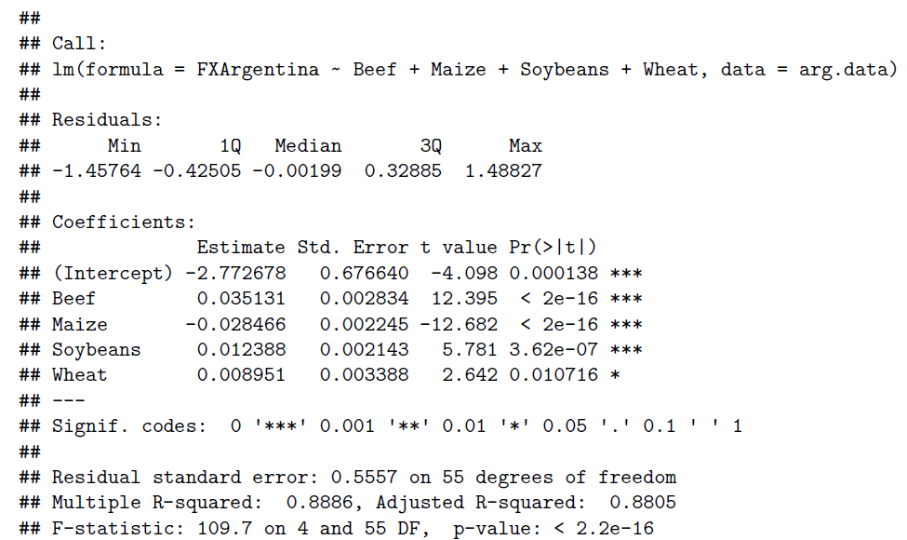
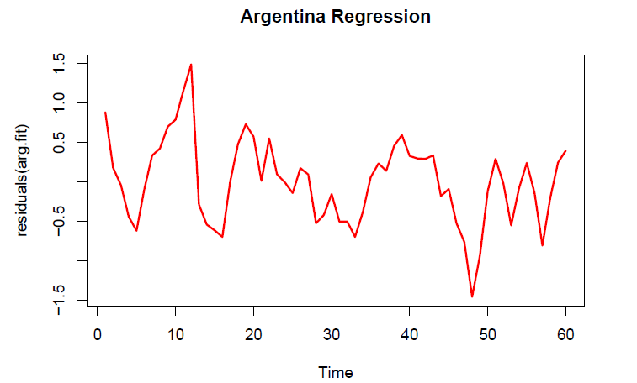
WORKING WITH DATA
Argentina
SUMMARY
REGRESSION
We see that all commodities have a influence on exchange rate. However, wheat seems to be the weakest being only influential at a 5% alpha.

Slide 8
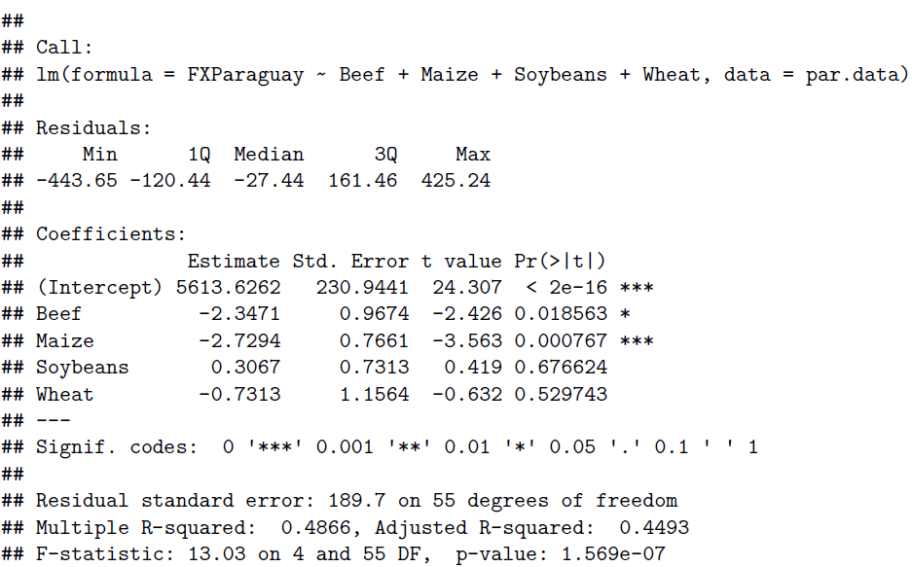
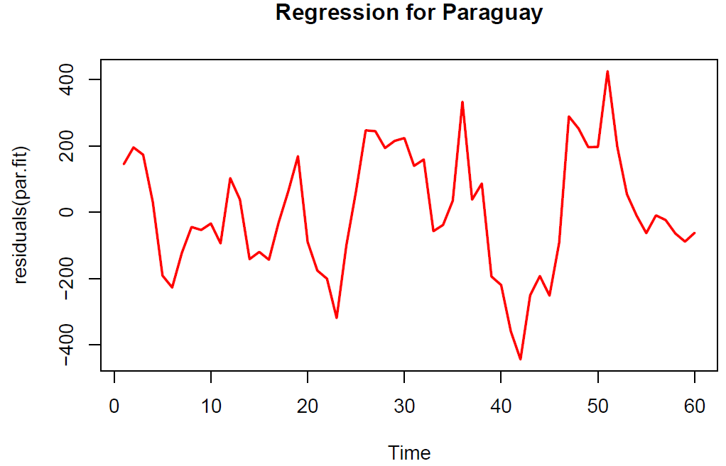
WORKING WITH DATA
Paraguay
Now, we repeat the same process with other countries’ data…
SUMMARY
REGRESSION
Only Beef and Maize are significant variables in this regression. Soybeans and Wheat do not seem to have an influence.

Slide 9
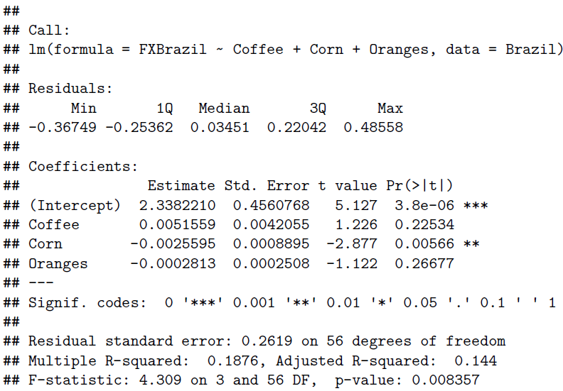
WORKING WITH DATA
Brazil
REGRESSION SUMMARY
Only corn is significant. Oranges and Coffee do not have influence on Brazil’s exchange rate.
Since Brazil has the highest GDP, we will go through the four assumptions to test the validity of our model.

Slide 10
MODEL TESTING
Brazil
ASSUMPTIONS
Assumption 1 - Expected(Residuals) = 0
```{r,echo=FALSE, warning=FALSE, results='hide'}
plot(cbind(residuals(Brazilregress), Brazil[,3:5]), lower.panel=NULL)
```
Assumption 2 - Predicted Value(Residuals)~0
```{r,echo=FALSE, warning=FALSE, results='hide'}
plot(fitted(Brazilregress), residuals(Brazilregress), xlab="Fitted", ylab="Residuals")
abline(h=c(-2,0,2), lwd= c(2,2,2),col=c("red", "red", "red"), lty=c(2,1,2))
Assumption 3 - Normality of Errors
```{r,echo=FALSE, warning=FALSE, results='hide'}
qqnorm(residuals(Brazilregress) ,ylab="Residuals")
qqline(residuals(Brazilregress), col="red", lwd = 2)
hist(residuals(Brazilregress))
```
Assumption 4 - Uncorrelated Errors
```{r,echo=FALSE, warning=FALSE, results='hide'}
plot.ts(residuals(Brazilregress), col="red", lwd = 2, main = "Brazilregress" )
```

Slide 11
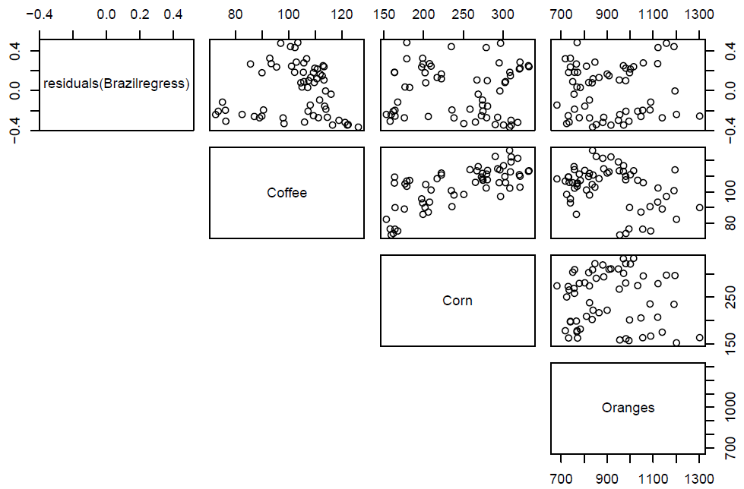
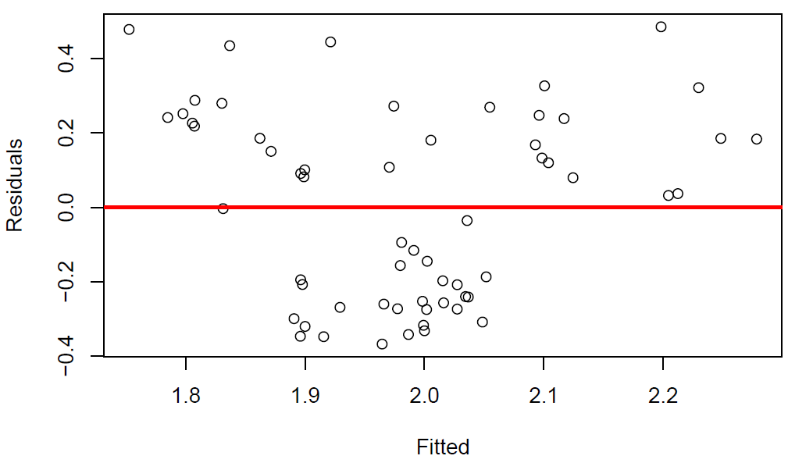
MODEL TESTING
Brazil
ASSUMPTION 1 - Expected(Residuals) = 0
ASSUMPTION 2 - Predicted Value(Residuals)~0
1. Even spread for Corn and Coffee on Exchange Rate. Coffee and corn have a relationship. There seems to be some pattern and non linear for coffee. We might consider a second order regression. || 2. We do not see other 2 lines indicating a good fit.

Slide 12
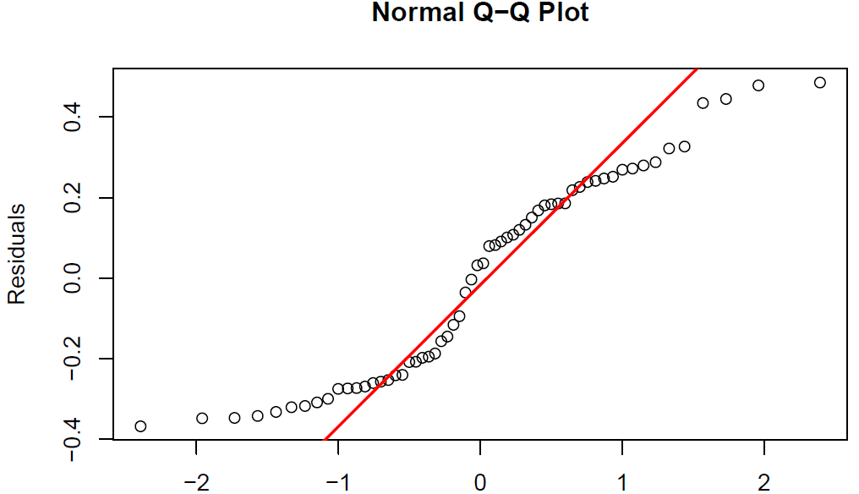
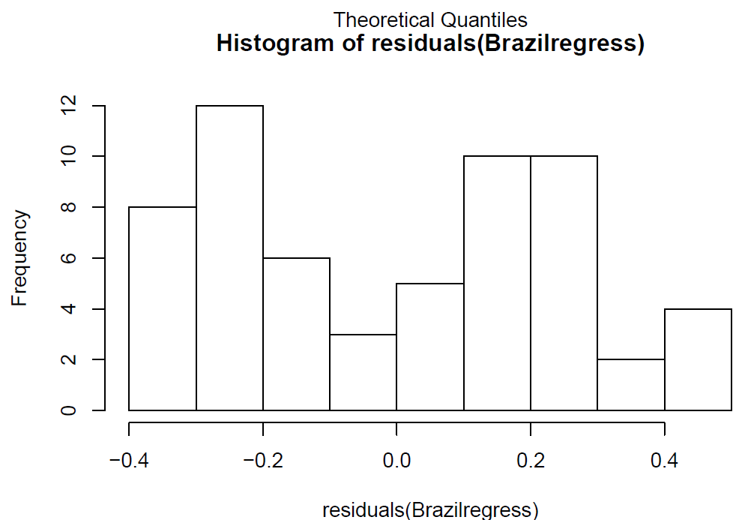
MODEL TESTING
Brazil
ASSUMPTION 3 - Normality of Errors
ASSUMPTION 3 - Normality of Errors
Several issues: throughout qqnorm and qqline the tails on both ends stem outwards. The histogram is not normally distributed--strongly skewed to the left and slightly to the right. May indicate that this isn't the best fit for our model.

Slide 13
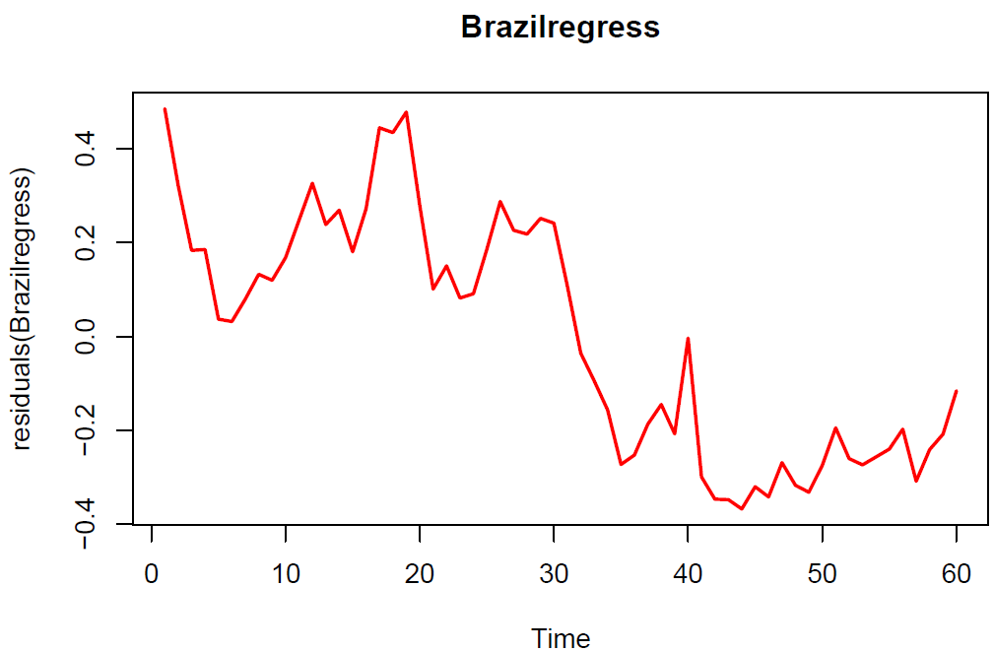
MODEL TESTING
Brazil
ASSUMPTION 4 - Uncorrelated Errors

Slide 14
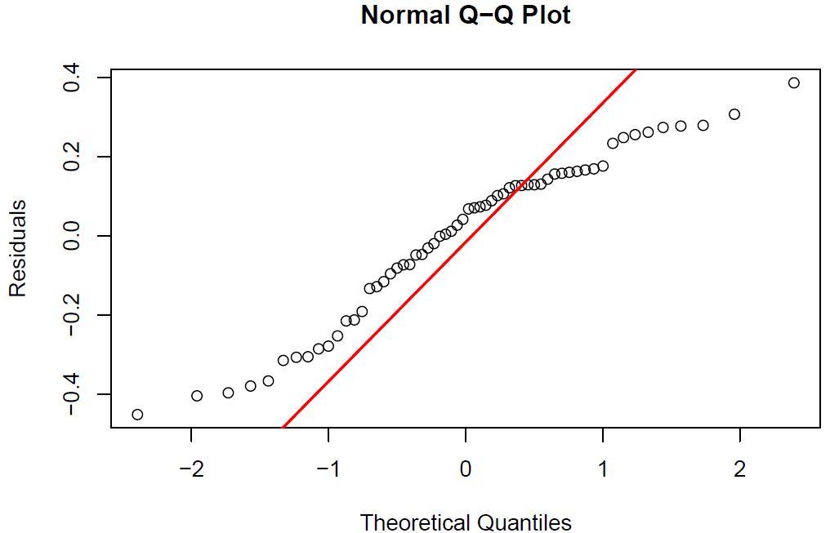
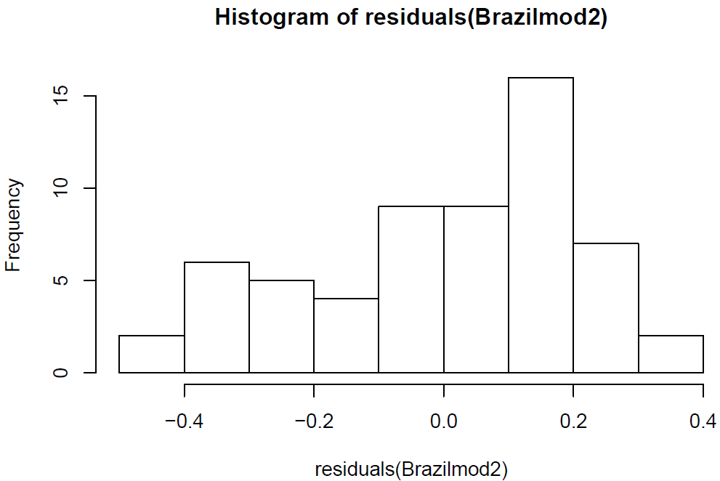
MODEL TESTING
Brazil
Add a polynomial into Brazil regression to fix coffee…stronger fit for coffee!
NEW QQNORM LINE
NEW HISTOGRAM
Adding the second order polynomial to coffee improved our histogram and made the qqnorm line straighter.
However, there seems to be a little multiplicative effect.

Slide 15
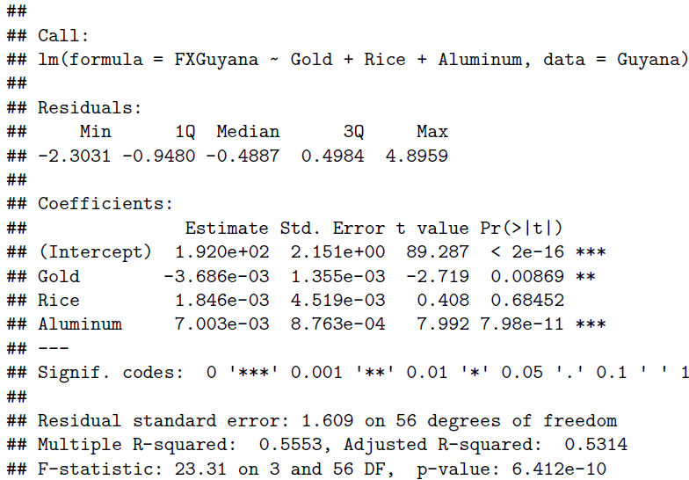
WORKING WITH DATA
Guyana
REGRESSION SUMMARY
Since Guyana has the lowest GDP, we will go through the four assumptions the same way as Brazil to test our model’s validity.

Slide 16
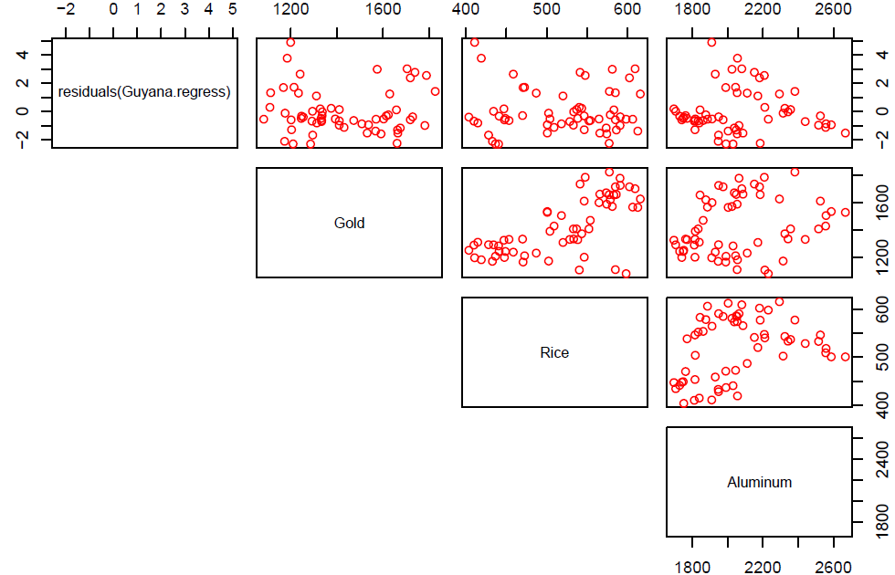
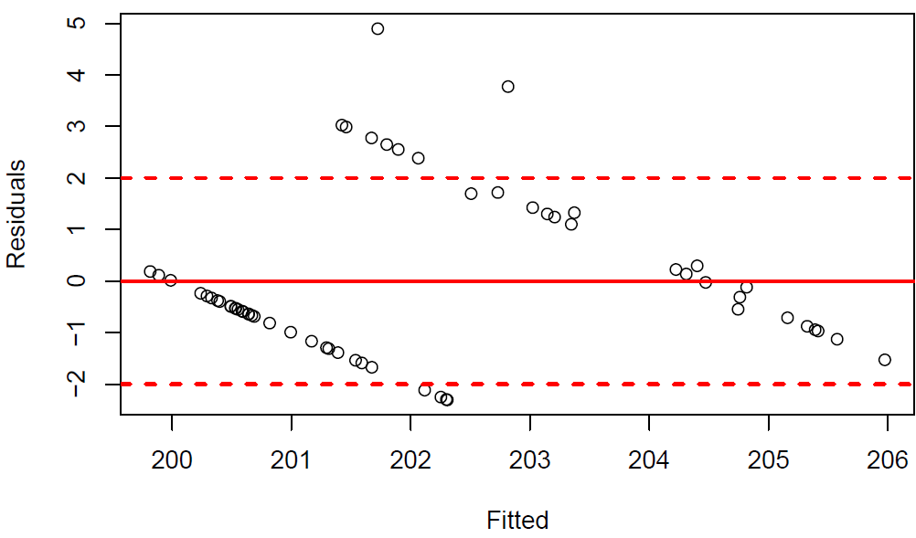
MODEL TESTING
Guyana
ASSUMPTION 1 - Expected(Residuals) = 0
ASSUMPTION 2 - Predicted Value(Residuals)~0

Slide 17
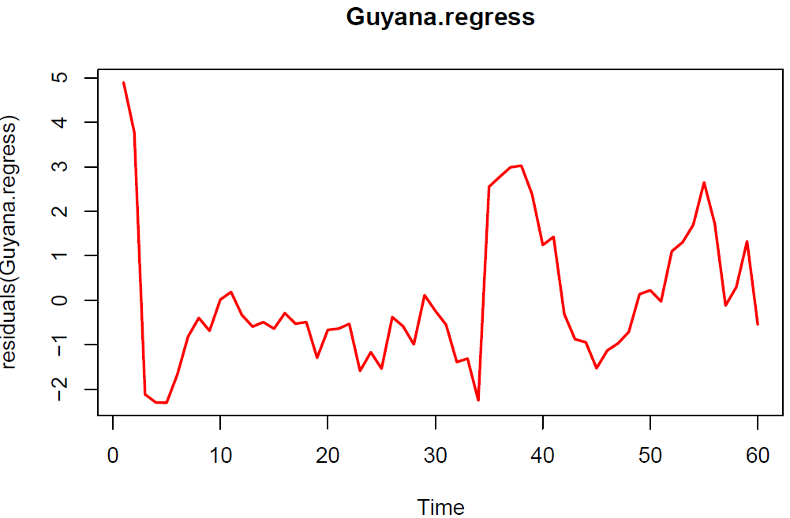
MODEL TESTING
Guyana
ASSUMPTION 4 - Uncorrelated Errors

Slide 18
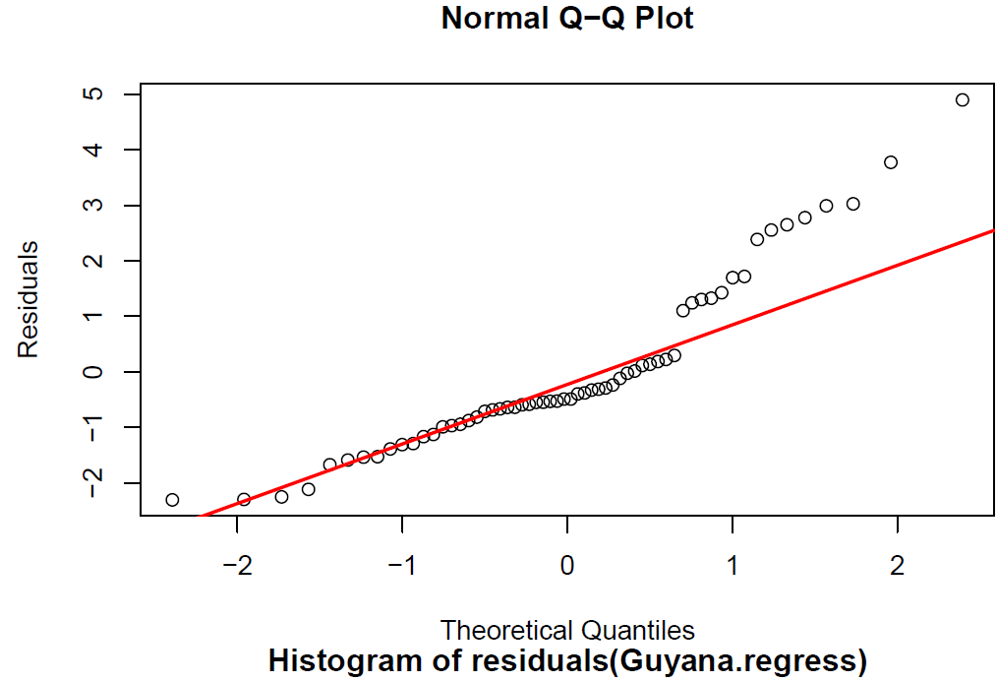
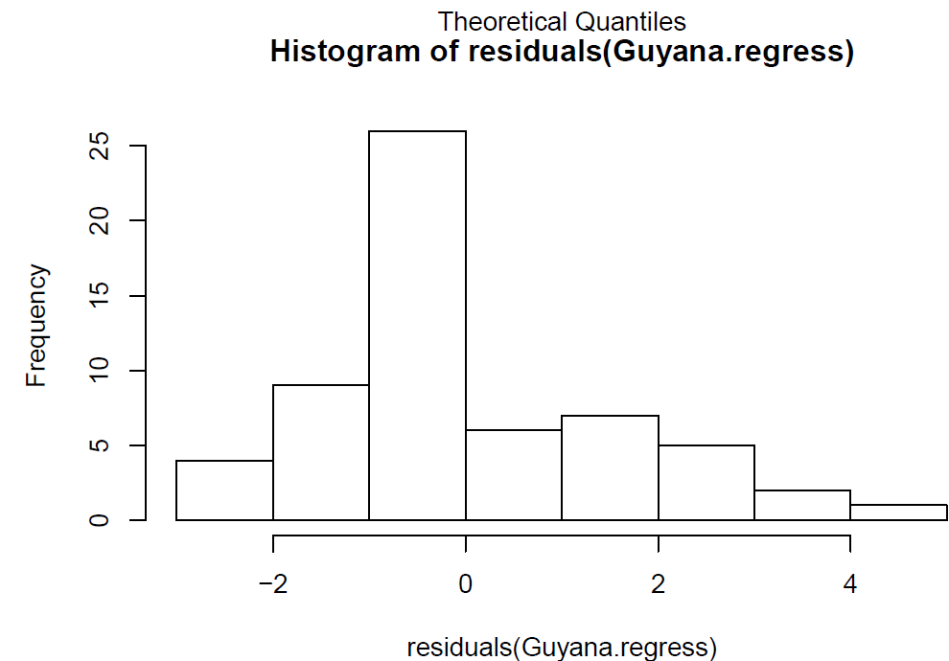
MODEL TESTING
Guyana
ASSUMPTION 3 - Normality of Errors
ASSUMPTION 3 - Normality of Errors
In our qqnorm line, we see that the right side is increasingly deflecting off the line. The histogram is also right-skewed. Therefore, normality does not exist.

Slide 19
WORKING WITH DATA
Columbia and Bolivia
Collapsed into monthly for consistency between datasets
Columbia: Retrieve data of Oil, Gold, Coal, Exchange Rates
Bolivia: Retrieve data of Zinc, Gas, Exchange Rates
Data for Columbia and Bolivia Regressions
Take the data that we want from the larger data set.
```{r}
Columbiacoal <- mydatacoalColumbia[,2]
FXcolumbia <- Columbiafx[,2]
FXboliva <- Boliviafx[,2]
GoldPrice <- mydatagoldColumbiaandBoliva[,2]
BoliviaGas <- mydatagasBolivia[,2]
ColumbiaOil <- mydataoilColumbia[,5]
BoliviaZinc <- mydatazincBoliva[,5]
```
RETRIEVING DATA
COMBINING DATA
Combine into respective countries using cbind.
```{r}
Columbia <- cbind(FXcolumbia, Columbiacoal, GoldPrice, ColumbiaOil)
Bolivia <- cbind(FXboliva, BoliviaGas, BoliviaZinc, GoldPrice)
```
Next, regress like previous datasets!

Slide 20
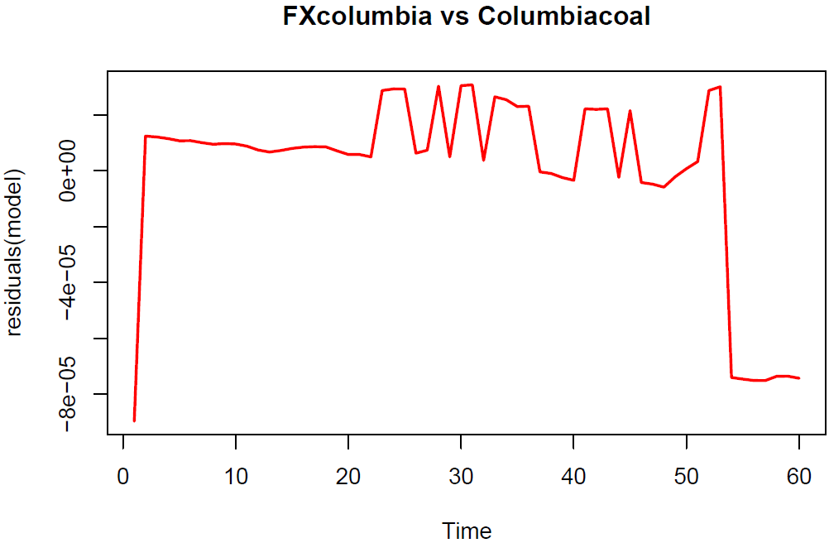
WORKING WITH DATA
Columbia
Exchange Rate vs Coal Price
REGRESSION
COMMENTS
Coal does not have a strong influence on exchange rate in Columbia. The p-value is 0.2482, not a strong correlation.
The variability of time reveals that FXcolumbia and Columbiacoal may not the best distributed model, but there may be a trend of these two variables.
The residual’s volatility may explain there is something in play with the coal market.
The impact on coal price might impact Columbia exchange rate.

Slide 21
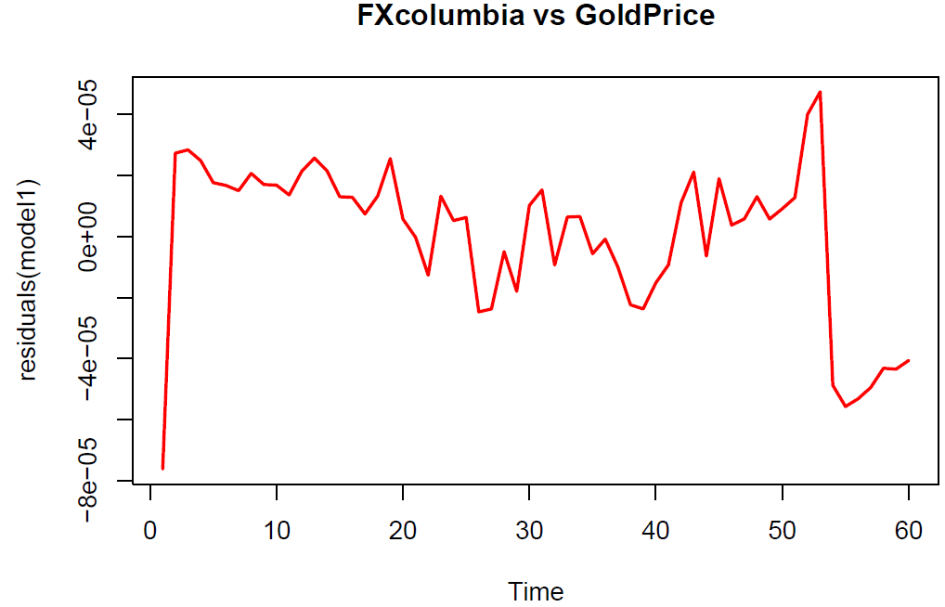
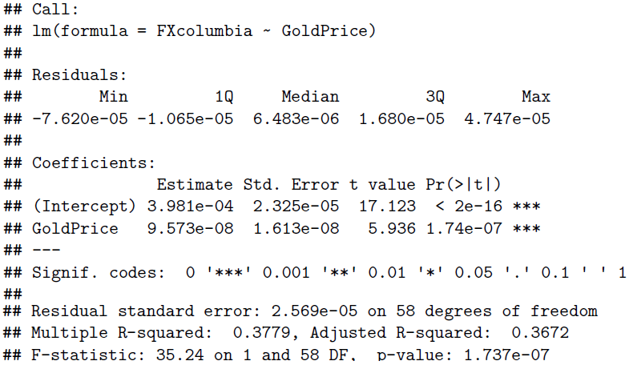
WORKING WITH DATA
Columbia
Exchange Rate vs Gold Price
REGRESSION
REGRESSION SUMMARY
Results show that gold prices do have a significant influence on exchange rate in Columbia. There is a trend with gold price and currency exchange that shows auto correlation. Amazing volatility between FXcolumbia and GoldPrice.

Slide 22
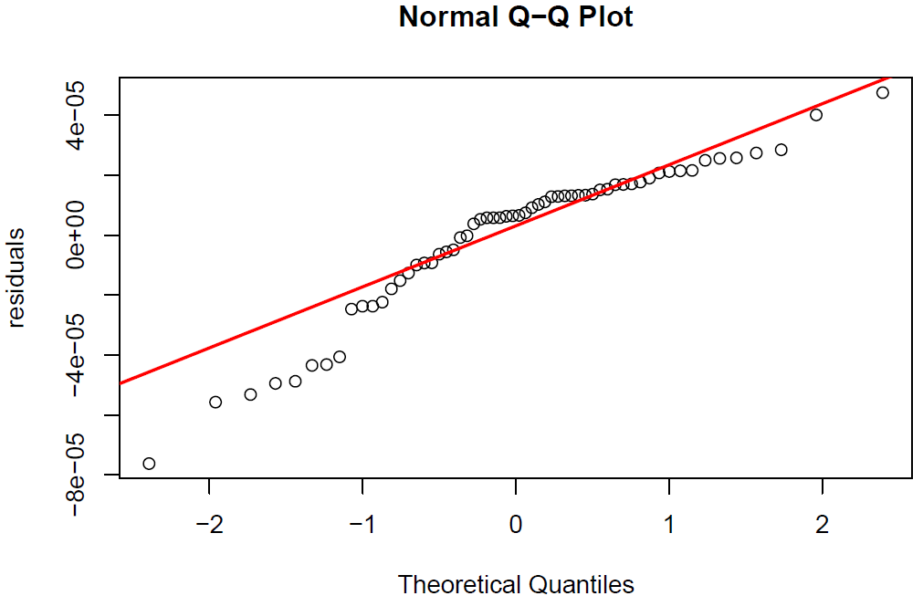
MODEL TESTING
Columbia
Q-Q plot shows normality as the end tails move away from the fitted line. This explains the price fluctuations between these two variables.

Slide 23
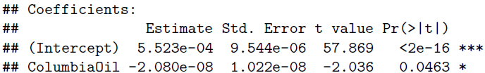
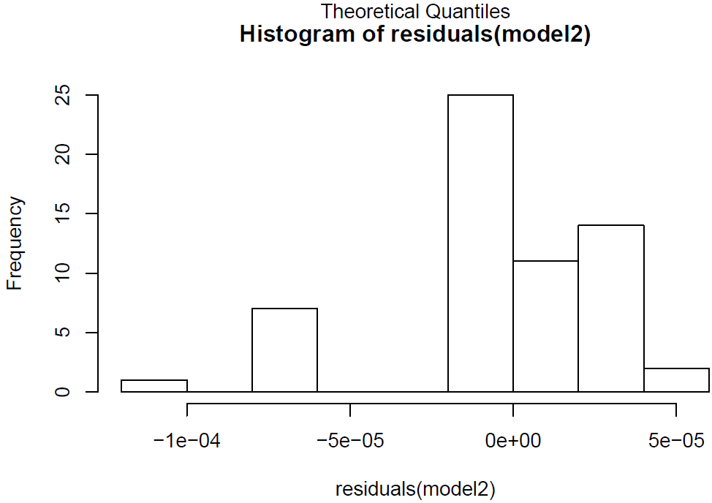
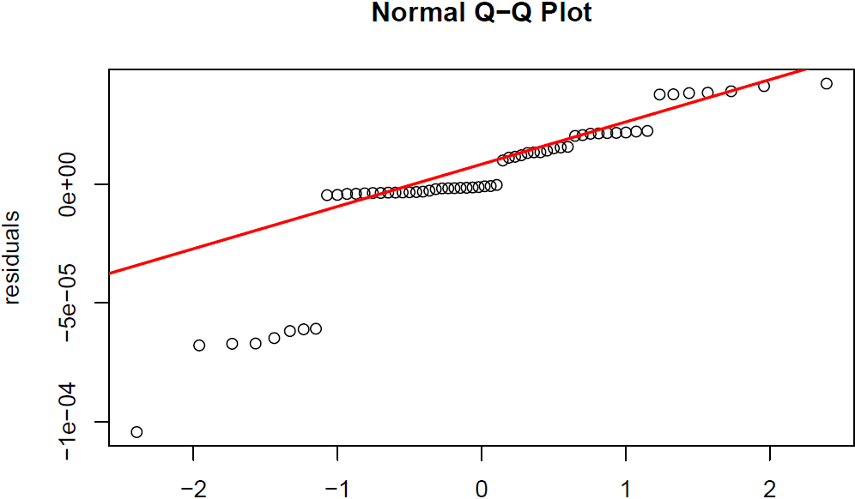
WORKING WITH DATA
Columbia
Exchange Rate vs Oil Price
REGRESSION SUMMARY
MODEL-TESTING
Strong P-value, but… MODEL-TESTING:
Oil prices are significant, but other commodities have strong influence for Columbia exchange rate. The Q-Q plot reveals that the tails not even close to the fitted line. Histogram tails are very extreme and there is no even distribution.

Slide 24
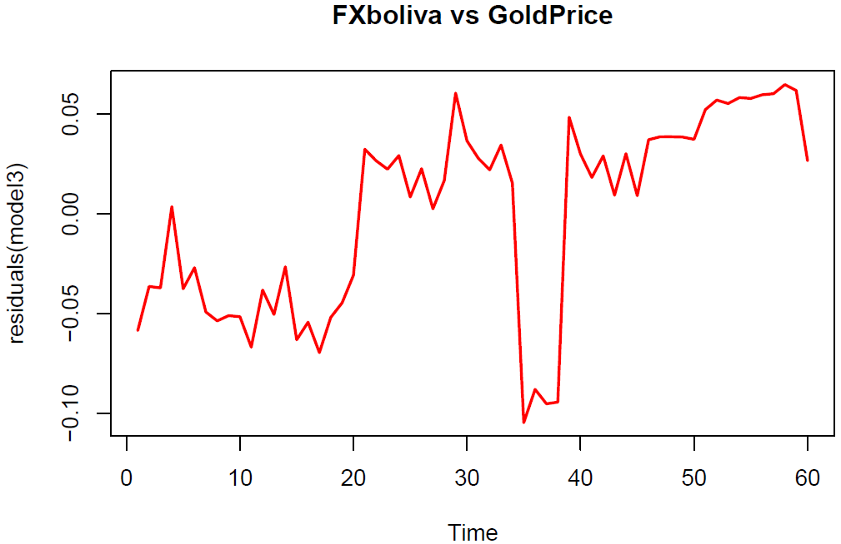
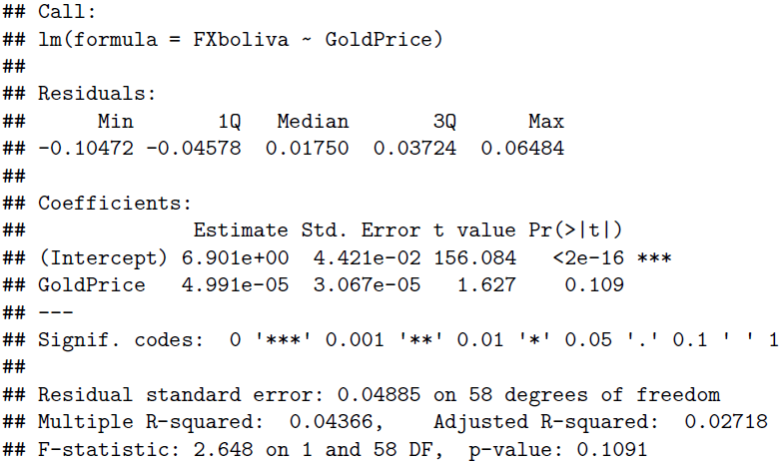
WORKING WITH DATA
Bolivia
Exchange Rate vs Gold Price
REGRESSION SUMMARY
REGRESSION
P-value of .1091 shows that the exchange rate and gold price are not strongly correlated. Therefore, gold prices do not influence the Bolivia exchange rates. The residual shows the rate of change between currency and gold price, and shows how volatile they are.

Slide 25
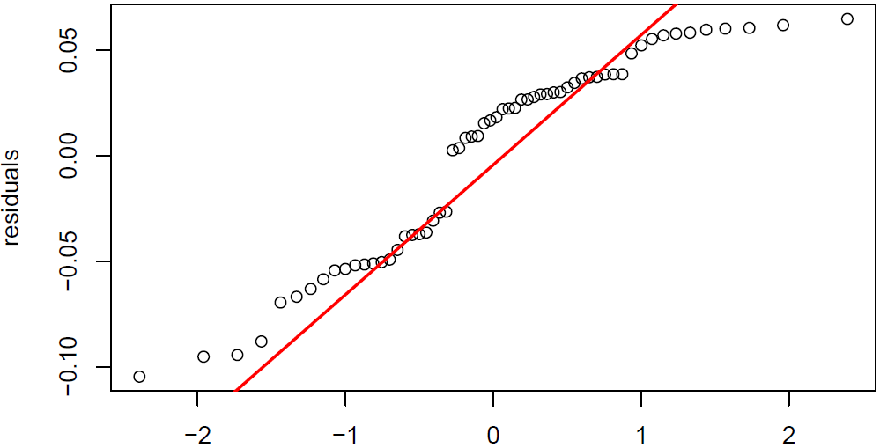
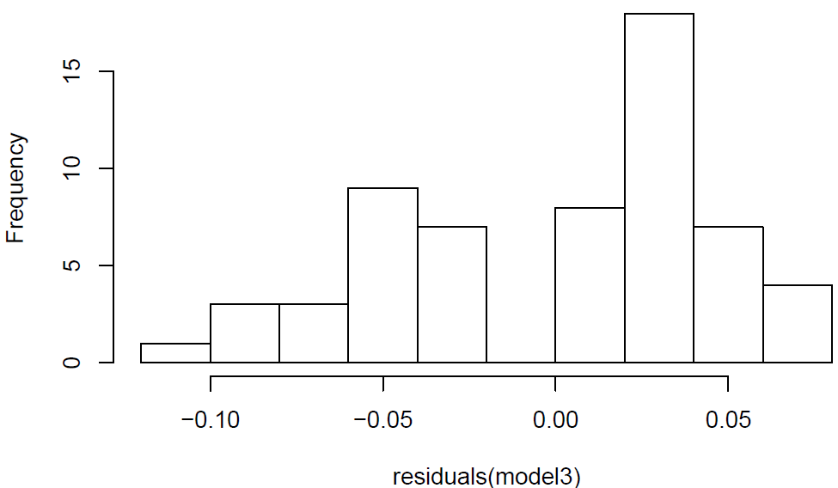
MODEL TESTING
Bolivia
Exchange Rate vs Gold Price
NORMAL QQPLOT
HISTOGRAM
Q-Q plot shows left and right sides deflecting off the line. Histogram is skewed to the left. This is likely from the volatility of Bolivian exchange rates.
Gold commodity prices and the Bolivian exchange rate don’t influence each other, but the volatile gold price shocks can make an impact on their exchange.

Slide 26
COMBINING PLOTS
Combine all the matrices into one to make it easier to create ggplot encompassing all data.
Use cbind: all our data have the same dates.
*Tip: -review the data(ie. duplicate function removed Maize and needed to be manually added
-to organize better, we can rearrange the columns
```{r, warning=FALSE, results='hide'}
alldata <- cbind(Bolivia, Columbia, Brazil, Guyana, arg.data, par.x)
duplicated.columns <- duplicated(t(alldata))
all.data <- alldata[, !duplicated.columns]
all.data <- cbind(all.data, com$Maize)
names(all.data)[21] <- "Maize"
names(all.data)
```
COMBINING MATRICES
1. We must select the data that we need - in this case the exchange rates. _Since we renamed the variable names, it is easier for us to call them._
2. Use mutate to the data to create a rate.
3. Added a sequence of numbers so that there is a general percent change in y for all the variables to compare to.
**Remember to add the piping functions and not to add on the last one or else it will go on infinitely**
```{r, warning=FALSE, results='hide'}
FX.delta <- all.data %>%
select(Date, FXBrazil, FXArgentina, FXcolumbia, FXboliva, FXParaguay, FXGuyana) %>%
mutate(Brazil.delta = 100*((FXBrazil - lag(FXBrazil)))/FXBrazil) %>%
mutate(Argentina.delta = 100*((FXArgentina - lag(FXArgentina)))/FXArgentina) %>%
mutate(Columbia.delta = 100*((FXcolumbia - lag(FXcolumbia)))/FXcolumbia) %>%
mutate(Bolivia.delta = 100*((FXboliva - lag(FXboliva)))/FXboliva) %>%
mutate(Paraguay.delta = 100*((FXParaguay - lag(FXParaguay)))/FXParaguay) %>%
mutate(Guyana.delta = 100*((FXGuyana - lag(FXGuyana)))/FXGuyana) %>%
mutate(Percentage.Change= seq(-100,100, by=3.35))
FX.delta
```
RATES OF CHANGE WITH PLYR

Slide 27
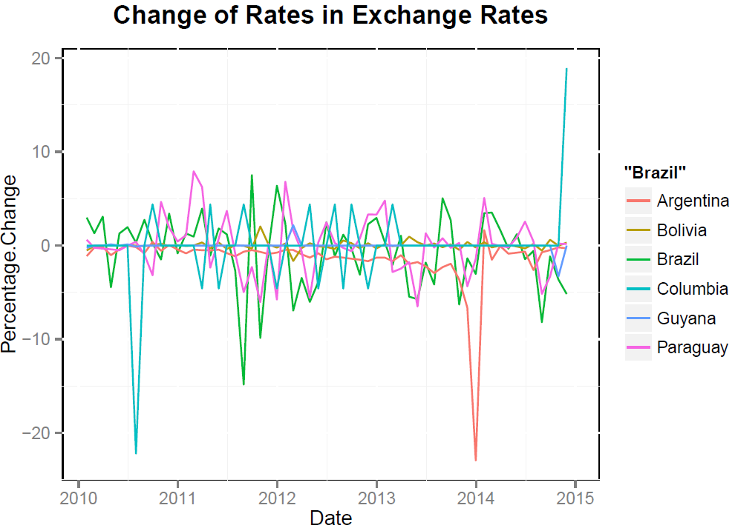
COMBINING PLOTS
EXCHANGE RATE GGPLOT
Argentina, Brazil, and Columbia seem most volatile compared to the other countries. The most stable currency is Bolivia,yet Bolivia is the poorest country in South America. It is natural for some currencies to be heavily correlated with commodity prices. So we need look further in Commodity prices.

Slide 28
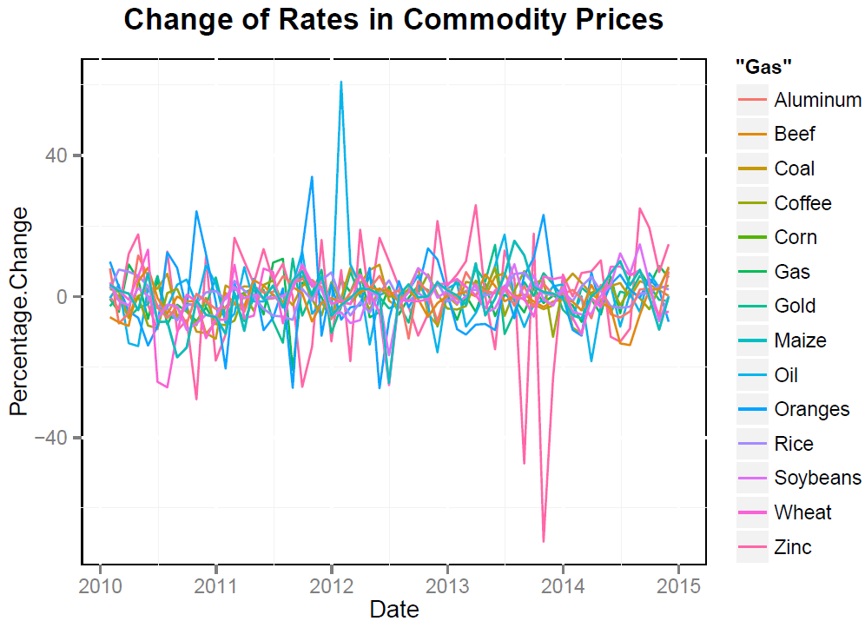
COMBINING PLOTS
COMMODITIES GGPLOT
We plot all commodities to show the general percent change of prices for the last 5 years. We know in general that most people in developed countries cannot buy commodities. Developed countries need to export their commodity resources to survive. We plot all of these commodity stocks together to show relationship as a whole.

Slide 29
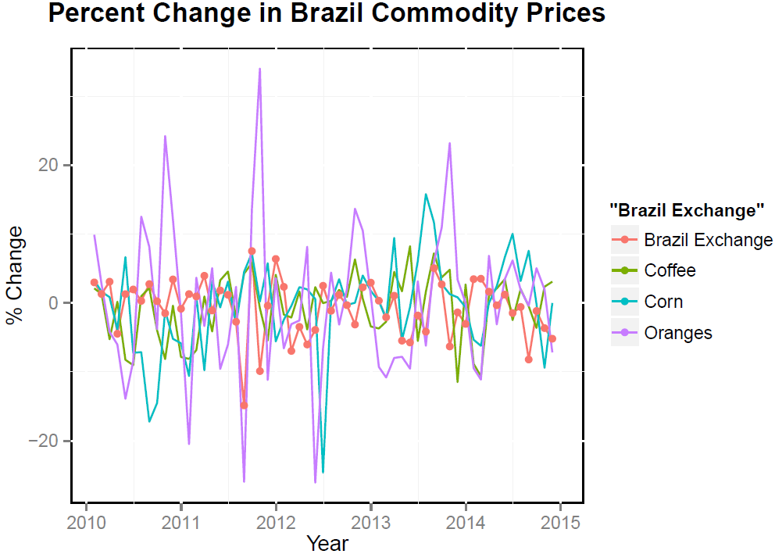
COMBINING PLOTS
Brazil Commodities Price Change Rates vs Exchange Rates
We create a matrix of all percentage changes of commodities and exchange rates. Use theme(), ggtitle() for visual effect
We see that oranges are the most volatile in the past 5 years. Additionally, mid 2012, there was a large price decrease for both corn and oranges.

Slide 30
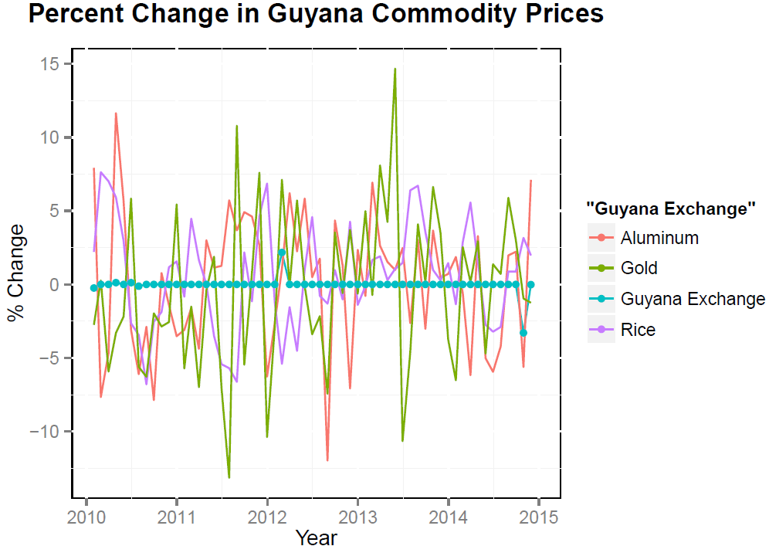
COMBINING PLOTS
Guyana Commodities Price Change Rates vs Exchange Rates
The highest volatility occurs for Gold prices in the last 5 years.

Slide 31
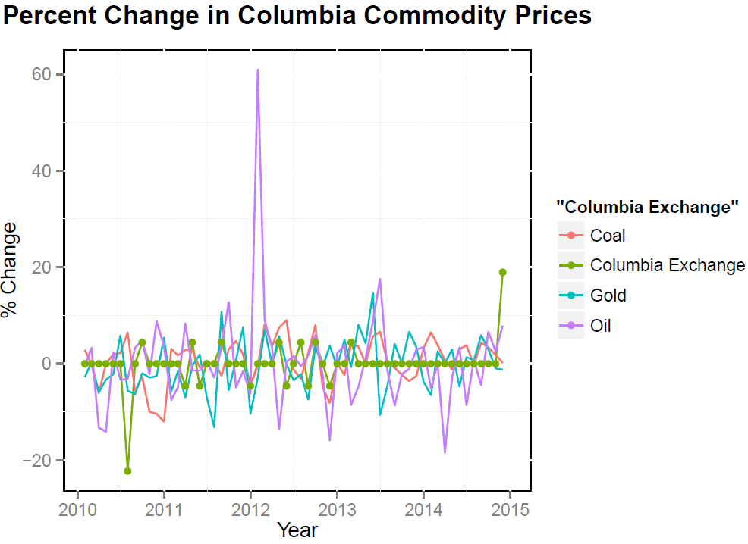
COMBINING PLOTS
Columbia Commodities Price Change Rates vs Exchange Rates

Slide 32
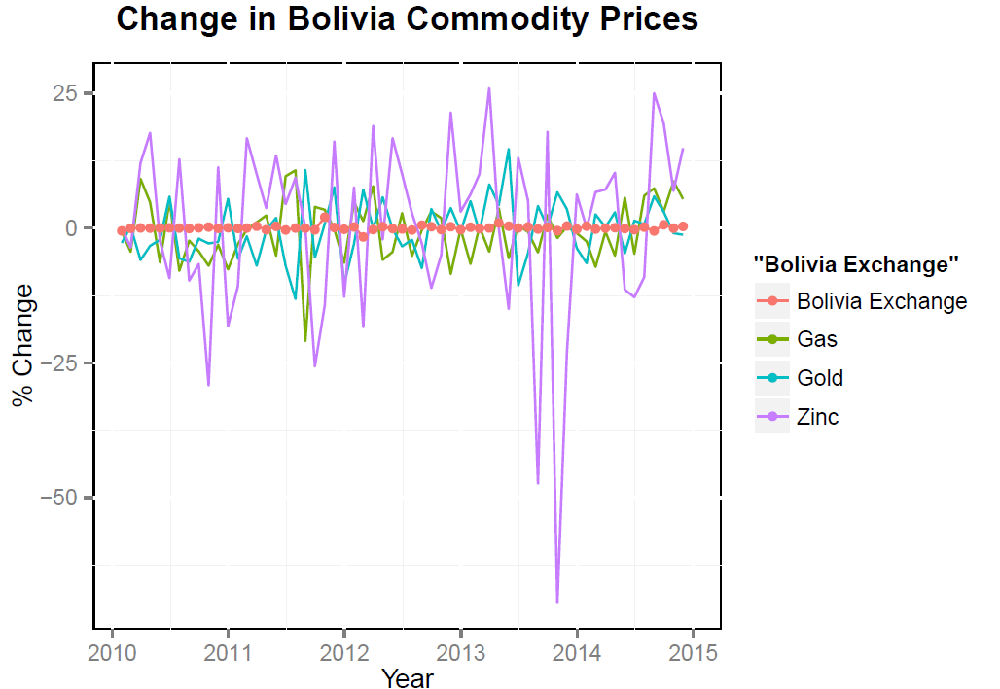
COMBINING PLOTS
Bolivia Commodities Price Change Rates vs Exchange Rates

Slide 33
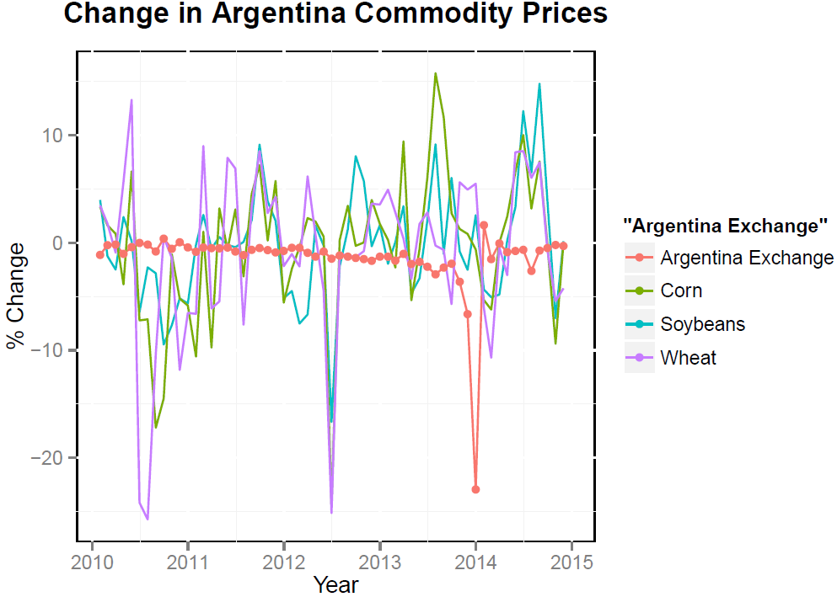
COMBINING PLOTS
Argentina Commodities Price Change Rates vs Exchange Rates
We see that the shocks generally range between -10% and 10%. However, wheat and soybean had large drops in mid 2010 and 2012. Furthermore, the Argentina Exchange rate had a large drop of about -25% in 2014.

Slide 34
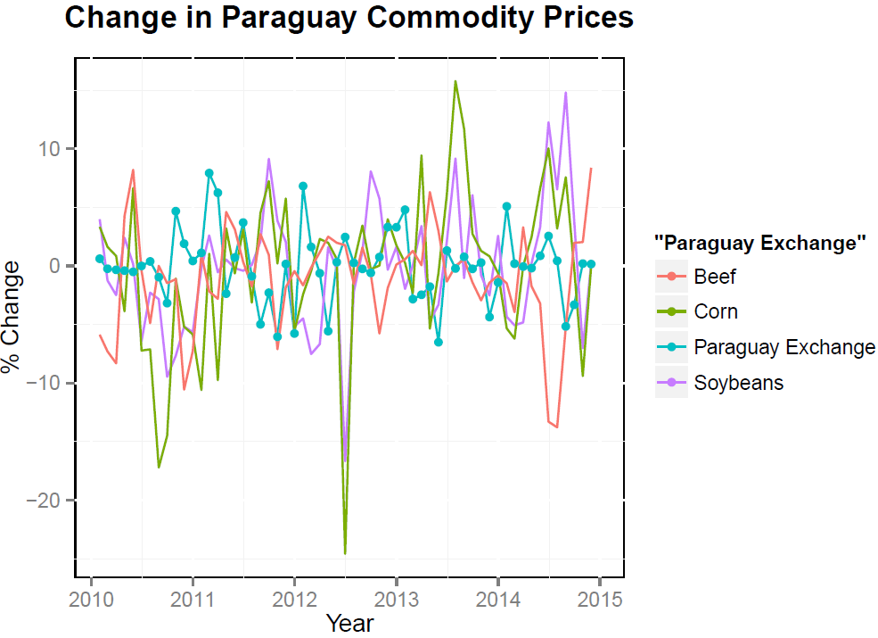
COMBINING PLOTS
Paraguay Commodities Price Change Rates vs Exchange Rates
We see that once again the volatility ranges between -10 and 10%. The largest drop occurred mid 2012 in Corn prices.

Slide 35
CONCLUSION
KEY TAKEAWAYS
Difficult to predict developing countries that rely on commodities as exports
Keep an eye on movements in important commodity markets in commodity currency country
Commodity prices respond quickly to currency market
- Slightly delayed impact of movements on currency market
Ultimately, it never hurts to be informed about commodity prices and how they drive currency movements!

Slide 36
Thank you

